Slide 1
CLDN1 Target Evaluation
Confidential 1

Slide 2
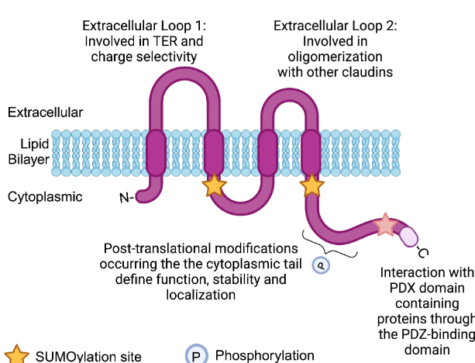
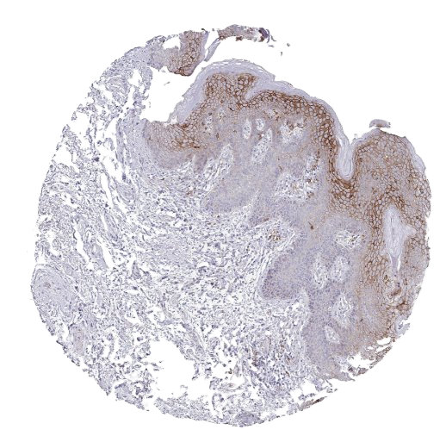
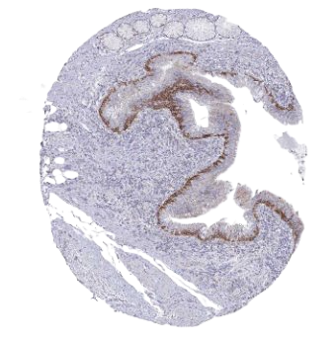
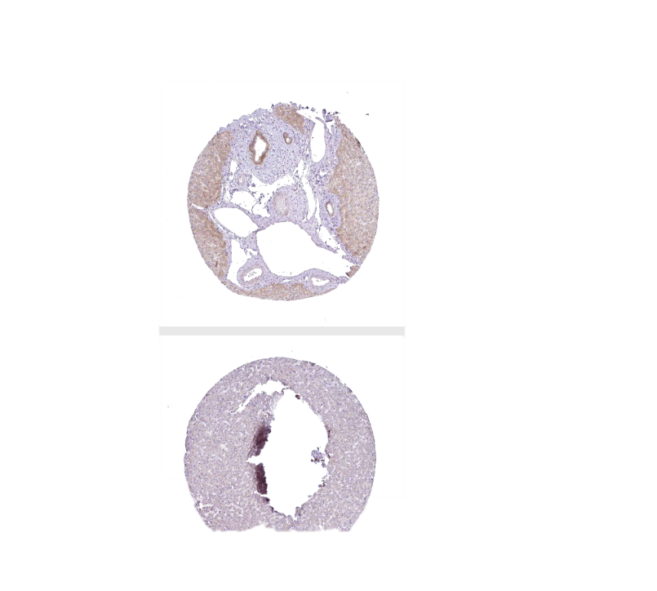
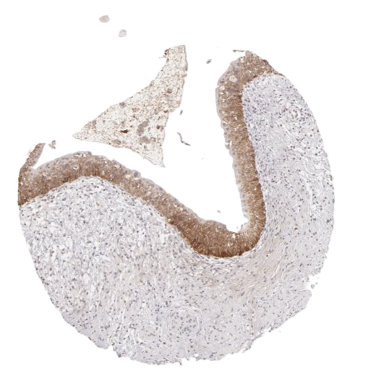
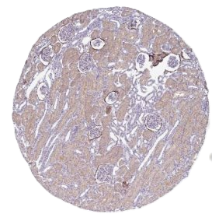
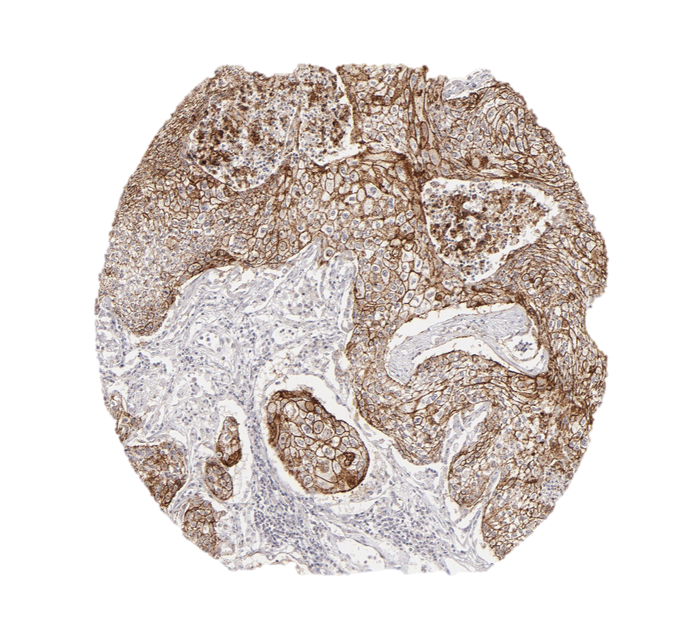
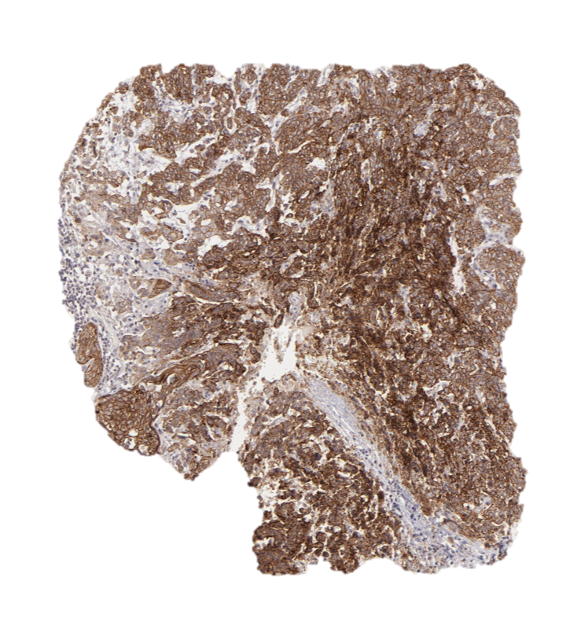
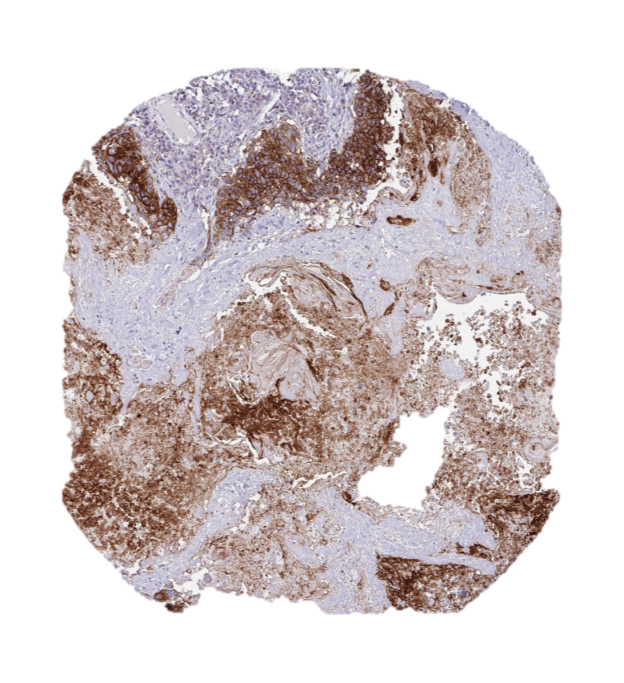
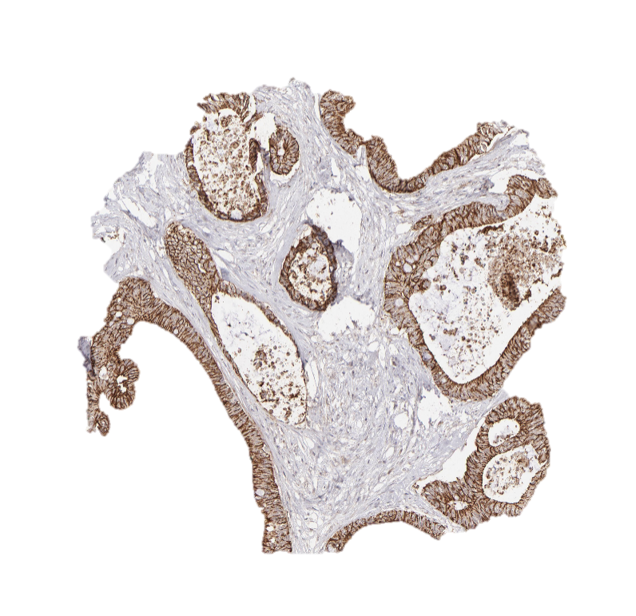
Multi-Cancer: CLDN1 tumor-specific accessibility & high expression create RLT window
Target Selection
Expression
Biology & Feasibility
Normal Tissues: Occupied in tight junctions
Tumor-specific accessibility | ✓ | Found outside tight junctions in tumors
Internalization | ✓ | Natively internalized
Secretion | ✓ | No observed secretion
Ligandability | ✓ | Peptides for other CLDN family members used in imaging studies
Inaccessible
Skin
Bronchus
Liver
Bladder
Kidney
Tumors: Diffuse expression, blood
Landscape
Accessible
No CLDN1 RLT in development, to our knowledge
Lung Sq
Cervical Sq
Head & Neck Sq
Colorectal
Sego’s Approach
Modality | CLDN1 peptide RLT
Positioning | 2L metastatic sqNSCLC with the goal of replacing current salvage tx. May combine with PD-L1.
Sources: Human Protein Atlas, Vonniessen Frontiers Onc 2024

Slide 3
Landscape
Clinical data for the claudin family strongly support CLDN1 as an RLT target
Alentis ADCs advancing in clinic
Preclinical CLDN1 ADCs show clean safety
Claudin family validates targetability
ALE.P02 (MMAE) — Ph 1/2 in CLDN1+ squamous tumors (HNSCC, sqNSCLC, ESCC); FDA Fast Track Nov 2024
ALE.P03 (Topo-I) — Ph 1/2 in adenocarcinomas (mCRC, cholangiocarcinoma, urothelial); initiated 4Q 2025
Early signals encouraging — mgmt reports robust responses in HNSCC and esophageal; dose-ranging data for both ADCs expected in 2026
No on-target DLTs across Alentis programs to date, a positive signal for CLDN1 as a therapeutic target
MW-C1-MMAE — tumor regression in CDX/PDX; no off-target tox in primate GLP tox studies (AACR 2025)
6-F6-MMAE — Focused on CRC, PDAC, OC; decreased tumor size and liver mets; synergistic with oxaliplatin
Xi-342 — neutralizing mAb, xenograft accumulation and tumor growth inhibition; no toxicity in humanized mice
No on-target, off-tumor safety signals in any disclosed preclinical CLDN1 molecule
Claudin family members are also tumor-specifically available, and occupied in juntions in healthy tissue. We can infer CLDN1 feasibility from other claudin family members:
Zolbetuximab (CLDN18.2) — approved for G/GEJ; confirms claudins targetable with tumor-normal window
Multiple CLDN18.2 programs in development further validate claudin target class
Ixotatug vedotin (CLDN6) — Ph 2 ADC; AEs consistent with payload, not on-target activity
RLT readthrough: absence of on-target DLTs across CLDN1, 6, 18.2 supports RLT feasibility
Sources: Roehlen, J of Hepatology 2023 , Cherradi ,J Exp & Clinical Cancer Res 2017, Mabwell AACR 2025, Alentis Webisite, Beacon Intelligence
Confidential 3

Slide 4
CLDN1 Details
Confidential 4

Slide 5
Tumor-specific accessibility of CLDN1 creates a therapeutic window for RLT
Biology
In cancer, Claudin 1 (CLDN1) becomes selectively accessible. Loss of polarity and tight-junction integrity in CLDN1-overexpressing tumor cells exposes the extracellular loops creating a therapeutic window well suited for peptide-RLT. In intact epithelia, claudin tight junctions form sub-nM pores that permit only small solutes and ions, excluding peptides and proteins from reaching the extracellular loops. CLDN1 is constitutively internalized; a route for RLT agents to enter the cell.
Total CLDN1 is overexpressed in 77% of Lung Squamous Cell Carcinoma, 75% HCC, 49% HNSCC, 80% of CRC, and in 70% of Squamous Cervical Carcinoma with lymph node metastases. CLDN1 has been confirmed to be available outside tight junctions in HCC and CRC patients and is likely to be available in other overexpressing tumors. Although CLDN1 is expressed in normal tissues (skin, tonsil, liver, bladder, and kidney), confinement in tight junctions provides a shield, minimizing off-target risk.
Antibodies against the CLDN1 extracellular loops validate this epitope as selectively available & druggable, and peptide ligands can be engineered to the same site. The approval of Zolbetuximab (CLDN18.2 mAb) further establishes the clinical relevance of claudin overexpression. Peptides provide an additional safety layer through rapid clearance and low background tissue retention avoiding the nonspecific accumulation seen with larger antibodies kept at saturating concentrations.
Tumors with known CLDN1 overexpression impact millions worldwide annually. All these indications have significant metastatic patient populations which lack effective treatment options. No other CLDN1 RLTs are in development, only CLDN1 targeted ADCs from Alentis Therapeutics currently in Ph 1 / 2.
Expression
Feasibility
Landscape
Sego’s Opportunity
Design a peptide-based RLT for CLDN1 that selectively targets an epitope available on tumor cells, creating a therapeutic window over healthy tissue. Possible application across multiple squamous & adeno-carcinomas.
Confidential 5

Slide 6
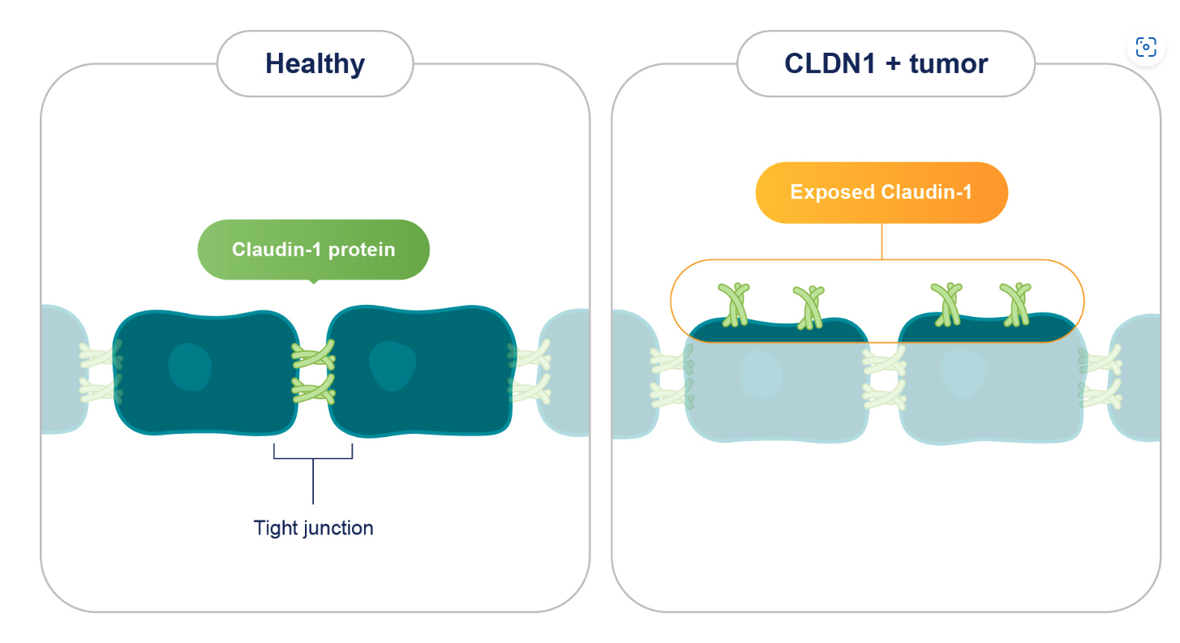
Biology
When overexpressed in tumor cells, CLDN1 is exposed and accessible for binding outside of normal location in tight junctions
Over-expression and loss of normal cellular polarization in tumor cells leads to excess CLDN1 exposed & accessible for peptide RLT binding on the cell surface.
CLDN1 is fully occupied in tight junctions in healthy cells. Tight junctions have an effective diameter of 0.6nM and restricts solutes larger than ~400 Da. Due to this, it is unlikely that a >1500 Da CLND1 peptide RLT would be able to bind healthy cells.
Sources: Vonniessen Frontiers Onc 2024, Hana Int J Mol Sci 2024 , Sekhar PLOS Pathogens 2018, Image – Alentis, Horowitz Nat Rev Gastroenterol Hepatol 2023
Confidential 6

Slide 7
Expression
CLDN1 is highly overexpressed in Squamous Cell Carcinomas & CRC
Normal tissues
Skin
Bronchus
Liver
Bladder
Kidney
Tumor tissues
Lung Sq
Cervical Sq
Head & Neck Sq
Colorectal
Sources: Human Protein Atlas
Confidential 7

Slide 8
Expression
CLDN1 is consistently overexpressed in Squamous Cell Carcinomas, CRC & HCC
Cancer Expression
Type | Method | Criteria | Value | Source
Protein | IHC | >25% cells moderate to strong staining for total CLND1 | 77% Lung Squamous Cell (38/49 samples), 17% Lung Adeno (7/41 samples). Staining maintained across stages/histologies. | Pschoud Modern Path 2007
 | IHC | H Score: High is defined as >170 | 49% “High CLDN1” in HNSCC . H score of ~10 for healthy tissue (71 total samples) | Nelhűbel Pathol Oncol Res 2014,
 | IHC | Human Protein Atlas Criteria | 75% of HCC show medium or high CLDN1 expression in human protein atlas, with additional confirmation with non-junctional CLDN1 mAb | Human Protein Atlas, Roehlen J of Hepatology 2023
 | IHC | Staining intensity by spot (0-neg, 1-yellow, 2-brown, 3-darkbrown) | 80% of adenocarcionoma CRC samples (36/45) positive for CLDN1 | Cherradi Journal of Exp & Clini Can Res 2017
 | IHC | Unpublished | 1200 samples, 12 indications – “NJ-CLDN1 is frequently overexpressed in solid tumors” and “25% high expression [of NJ-CLDN1] in CRC” | Alentis, Feb ’25. Private Co. Panel, Guggenheim
 | IHC | Staining high intensity (>75% positive) | ~80% of squamous Cervical Carcinoma samples in HPA dataset have high staining intensity | Human Protein Atlas
Protein | Omics |  | 1.6- to 2-fold higher tumor expression compared to normal adjacent tissue | HPA, CProSite,
mRNA | RNAseq | Significant fold increase of ≥10 (0.05) | 30-fold higher than normal tissue in colon, 2-fold higher in HNSCC, 9.7-fold higher in LungSq | TCGA
Healthy Tissue Expression
Type | Method | Criteria | Value | Source
Protein | IHC | Minimal or absent staining (ideally <1–10%; 0% preferred)​ | Squamous epithelial skin cells, tonsil squamous, bladder, liver, kidney have moderate to high expression of the CLDN1 | Human Protein Atlas CProSite
mRNA | RNAseq |  | Similar to above | GTex /TCGA
Confidential 23

Slide 9
Biology
CLDN1 is surface available, natively internalized & not shed – ideal RLT properties
Well-established structural features
No shedding into serum
4-pass tetraspan tight junction protein (~22–23 kDa) with two extracellular loops (ECL1, ECL2) and cytosolic N/C termini.
While there is no empirically derived crystal structure, multiple AF-derived homology models exist for structure-based drug design.
CLDN1 largely governs paracellular ion selectivity/barrier “tightness”. CLDN1 based junctions are typically extremely tight, and do not permit peptide sized molecules in. Injury may weaken these junctions.
Core determinant of epithelial barrier integrity; CLDN1 loss disrupts epidermal barrier (Cldn1⁻/⁻ mice die within 1 day from dehydration).
There is no convincing evidence any significant amount of CLDN1 is shed into the serum.
This minimizes the risk of a soluble antigen sink in the serum and reduces off-target exposures.
Natively & rapidly internalized
Constitutively endocytosed via clathrin coated pits and micropinocytosis
Kinetics: surface biotinylation assays indicate a substantial pool is internalized rapidly, signal plateau by ~30 min and ~35% internalized by 60 min in MDCK cells (then recycled)
Likely would carry RLT into cell which is ideal
Sources: Vonniessen Frontiers Onc 2024, Dukes MBC 2011, Zwanziger An NY Acad Sci 2012, Dukes PLOS One 2012, Utech J Biomed Biotech 2009, Karabulut Mol Clin Oncol 2015, Tas Melanoma Res 2016, Mattern Sci Rep 2019, Overgaard Antioxid Redox Signal 2011, Tsumagari Science 2021
Confidential 21
Notes:
Notes for later: on shedding Single pass, dual pass transmembrane domain proteins and GPI-anchored proteins are typically shed while tetraspan proteins including Claudins are generally not shed into the serum.
CLDN1s extracellular loops are small 20-55 amino acids ,while most well known shed proteins like EGFR and PSMA have large ectodomains of ~600 and 700 amino acids.
There is no convincing evidence any significant amount of CLDN1 is shed into the serum.-1 really bad paper with an sandwich ELisa ,likely signal is from exosomes not shed versions. And had lower expression in cancer than healthy which is not expected, casting doubt on the publication.
This minimizes the risk of a soluble antigen sink in the serum and reduces off-target exposures.

Slide 10
Landscape
Significant market opportunity for a CLDN1-RLT across diverse set of indications
Metastatic Lung Squamous Cell
Metastatic
Head & Neck Squamous Cell
Metastatic Hepatocellular Carcinoma
Incident Pts (US) | 50,000 | 65,000 | 40,000
% distant at diagnosis | 50% | ~15% | ~21%
Mean survival | 1 yr | 1 yr | 1 yr
% CLND1 positive | 77% | 49% | 75%
Rough estimate*: CLDN1 RLT patients | >20,000 | >4,800 | >6,300
*Estimates do not factor in patients who may become metastatic over the course of treatment, which may significantly increase potential CLDN1 pts
Sources: Pschoud Modern Path 2007, Nelhűbel Pathol Oncol Res 2014, Roehlen J of Hepatology 2023, SEER, Carisse Medicine 2019 Daloiso Cancers 2024, Bar J Ocology 2021, Uchino Cancer 2011, Cherradi Journal of Exp & Clinical Cancer Res 2017, ACS Cervical Cancer, Cheng Front Med 2025, Li J Gynecol Oncol 2016
Confidential 24
Notes:
Claudin-1 and claudin-5 expression patterns differentiate lung squamous cell carcinomas from adenocarcinomas - ScienceDirect
The prognostic role of claudins in head and neck squamous cell carcinomas - PubMed Treatment of HCC with claudin-1-specific antibodies suppresses carcinogenic signaling and reprograms the tumor microenvironment - Journal of Hepatology

Slide 11
Landscape
Example Target Product Profile for CLDN1-RLT in 2L metastatic sqNSCLC
Mechanism / Mode of Action | CLDN1-RLT, peptide ligand conjugated to chelated ²²⁵Ac that is internalized to deliver cytotoxic radiation directly to tumor cells
Clinical Trial Design | Randomized Phase 3 registration clinical study in locally advanced or metastatic squamous NSCLC that has failed platinum-based chemotherapy and/or anti-PD-1 /PD-L1 immunotherapy
Indication / Target Patients | Radiologically CLDN1 positive sqNSCLC patients with metastatic disease who have received and progressed after ≥1 prior systemic therapy specifically post-PD-L1 and/or post-platinum
Dosing Regimen & Administration | Intravenous infusion of CLDN1-RLT for 4 doses, 4 weeks apart and 2 doses every six months following initial cycle until progression
Clinical Endpoints | Primary Endpoints: Overall Survival (OS) Secondary Endpoints: Progression Free Survival (PFS) Overall Response Rate (ORR) Disease Control Rate (DCR)
Efficacy |  | CLDN1-RLT | Docetaxel + Ramcirumab
 | Dosing Schedule | See above | Ramucirumab 10 mg/kg + docetaxel 75 mg/m² q3w
 | ORR | >40% | 27%
 | DCR | >70% | 60%
 | OS | 11 mo (HR 0.85) | 9.5 mo
 | rPFS | 5 mo (HR 0.85) | 4.2 mo
Safety / Tolerability | Grade ≥3 TEAEs Fatigue (Grade ≥3) Neutropenia (Grade ≥3) Leucopenia (Grade ≥3) | <35% <30% <15% <25% | 79% 55% (14%) 55% (49%) 21% (14%)
Sources: Paz-Ares Lung Cancer 2017, Garon Lancet 2014
Confidential 11

Slide 12
Opportunity
Sego’s differentiated approach to CLDN1
 | Sego’s Approach
 | CLDN1-targeted cyclic peptide RLT
Modality | Cyclic peptide targeted to the ECL regions of CLDN1
Isotope/Payload | ²²⁵Ac or ¹⁶¹Tb
Internalization | Select for internalizing peptides to utilize increased cytotoxicity with internalized alpha and auger emitters
Advantage | CLDN1 is selectively available to RLT in tumors, reducing off tumor, on target toxicity risks. Novel target for RLT field, with pan-squamous cancer potential
Confidential 26

